Slide 1
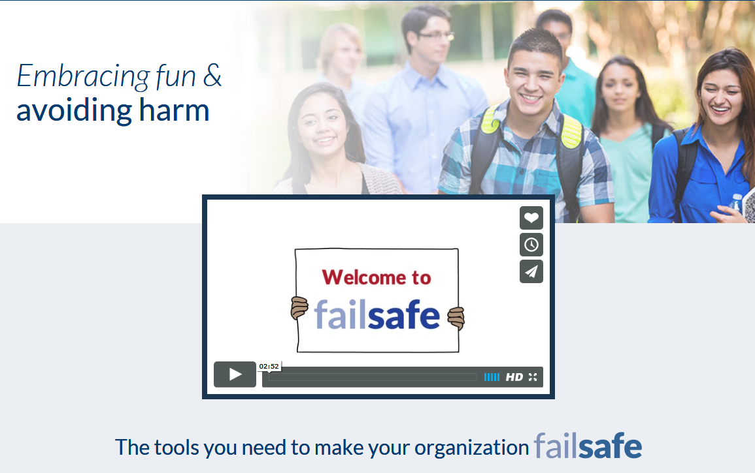
Providing New Solutions to an Ongoing Problem:
The Failsafe Student Leader Toolkit
  Thomas A Workman, Ph.D.
    Principal Researcher, Health
Notes:
I appreciate the opportunity to be here today, and deeply appreciate the chance to thank you personally for supporting this work. Because of the generosity of the Foundation, campuses will be able to address alcohol abuse among college students in ways that make the most sense and offer the best evidence-based tools to address the problem.

Slide 2
Understanding the Project
Theoretical basis: Edgework
Edgework and Effective College Alcohol Prevention
The Failsafe Toolkit
Enabling Peer Leadership and Peer Enforcement through the Toolkit: Models of Use

Slide 3
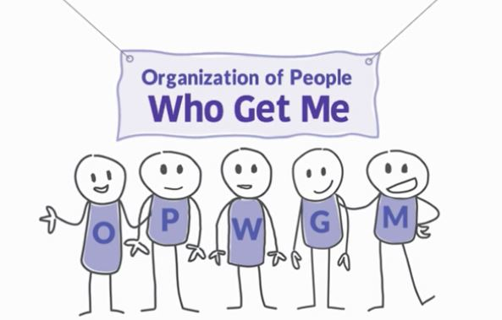
How We Establish Social Community: You = Me

Slide 4


Slide 5
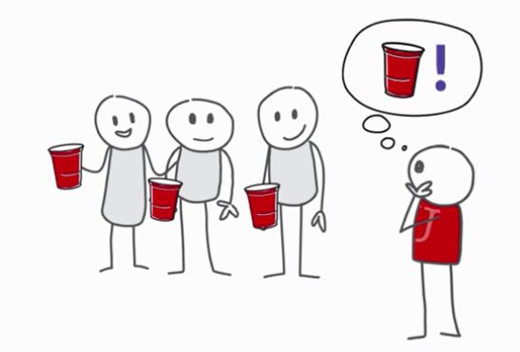

Slide 6

  Sociological theory describing and explaining voluntary risk-taking.
Occupational Edgework Communities
Recreational Edgework Communities
Elicit Edgework Communities
Notes:
Some communities are formed around high-risk activities.
Communities are “known” for their risk-taking; becomes part of member identity.
Entrance and acceptance to these communities is based on successful negotiation of risk, or “getting to the edge and back” without affecting daily responsibilities.

Slide 7
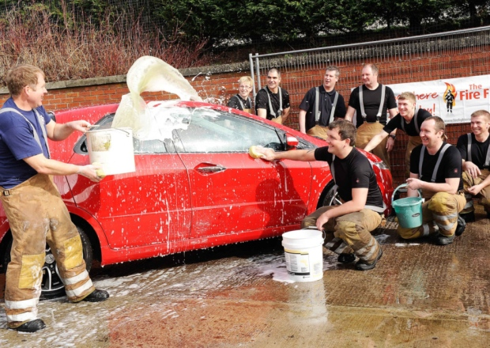
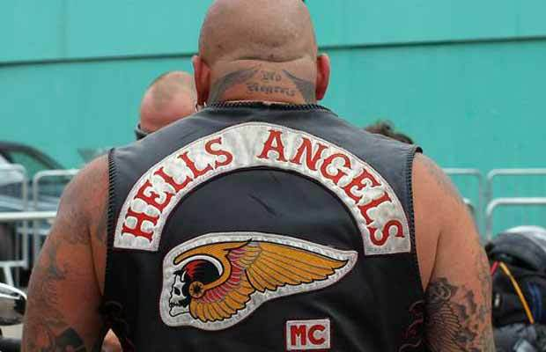
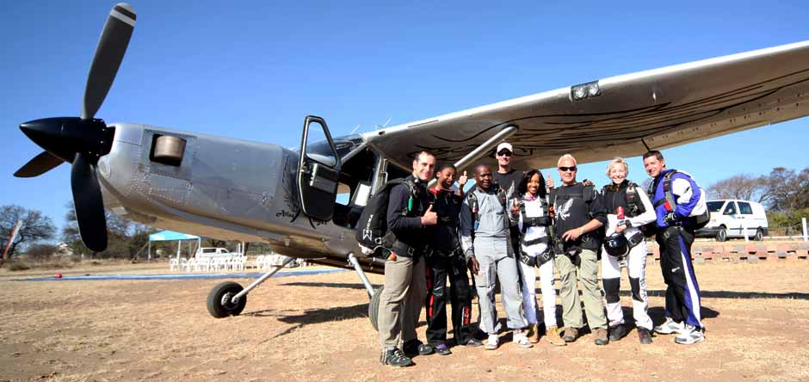
High Risk Behavior can be the basis of COMMUNITY

Slide 8
Principals of “Edgework” Communities
  Communities are “known” for their risk-taking; risk-taking becomes part of member identity.
  Entrance and acceptance to these communities is based on successful negotiation of risk, or “getting to the edge and back” without affecting daily responsibilities.
  Successful risk-taking provides social capital to the members.
  Unsuccessful risk-taking leads to member disfavor and often rejection.

Slide 9
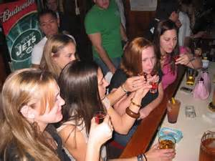
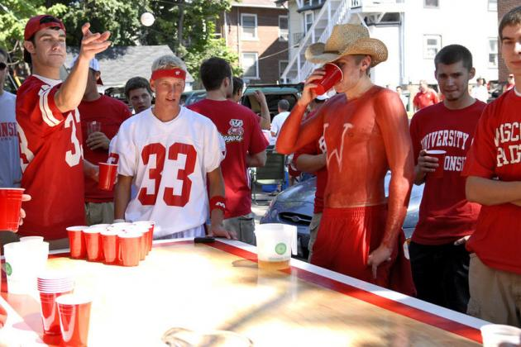

High Risk Drinking as Edgework
Drinking is done in groups during social events.
Drinkers with similar habits tend to cluster in formal and informal social groups.
Drinking is connected to membership rituals and traditions in some student groups/communities.
New members are most vulnerable and least successful; First- and second-year students account for the largest majority of acute intoxication injuries.

Slide 10


The ticket to membership: SKILL
Can you get to the edge of the cliff without falling off?
  Can you do it and not get in trouble?
  Can you do it and still make it to class/finish the paper/ace the test?
  Can you do it and not get accused of something?
  Can you do it without anyone getting upset or angry?

Slide 11
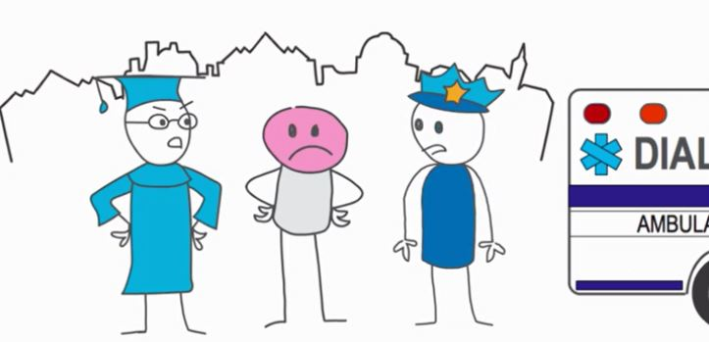
What makes an edgework community go over the edge?
The risk behavior of the members no longer brings positive outcomes.

Slide 12

Edgework Communities Thrive in an Environment of Ambivalence

Slide 13
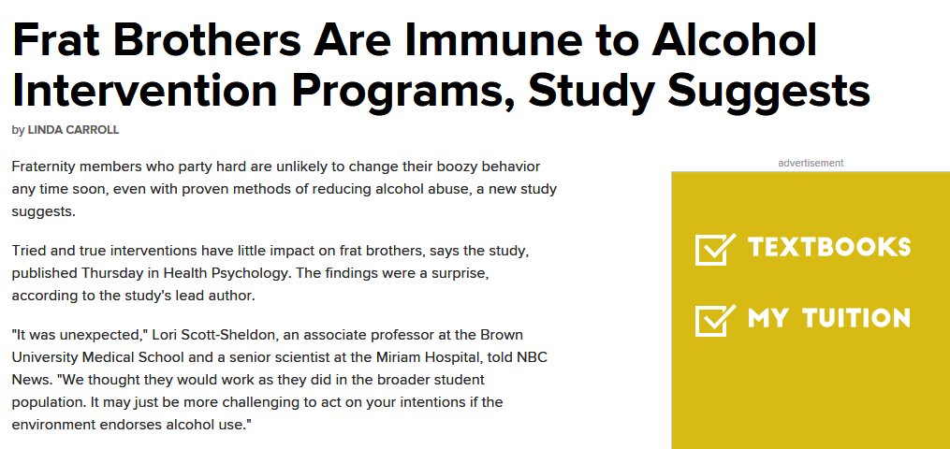
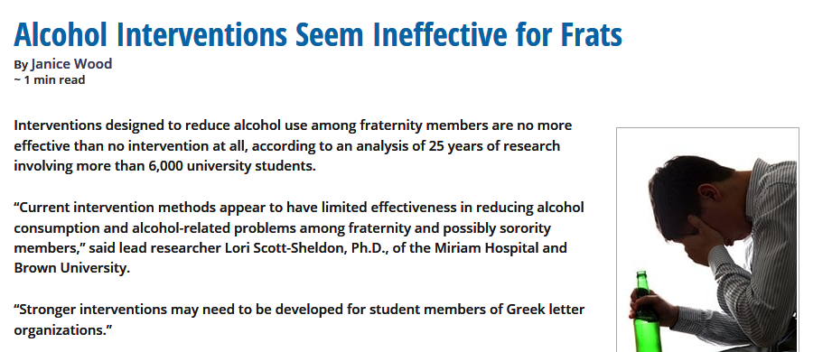
2016
Notes:
The focus is heavily on high risk groups, although few strategies focus here.

Slide 14

Student Leaders Influence Student Members, even in Edgework Communities
Older, more experienced drinkers hold highest reputation for successful edgework and are seen as role models.
These leaders are often viewed as critical audiences for edgework behaviors by new and prospective members.
“Reality Checks” from these individuals are adhered.

Slide 15
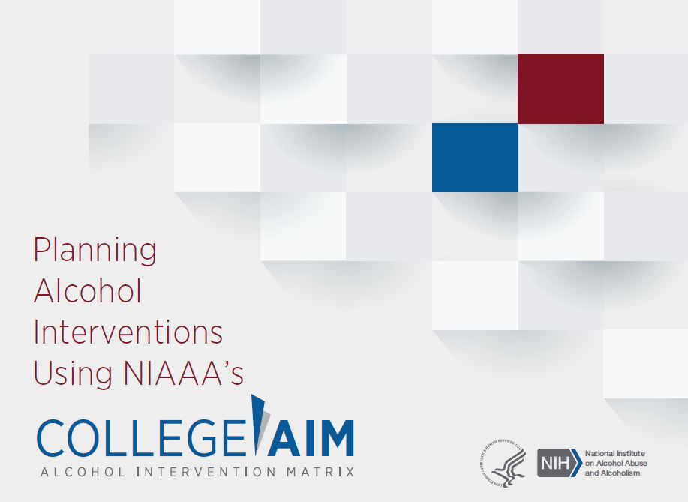
Employing Evidence-based Strategies to Edgework Communities
Adapting individual level strategies for implementation in student organizations
Providing turnkey materials to student leaders to implement the strategies
Focusing strategy implementation as a way to increase group success, not just solve a drinking problem.

Slide 16
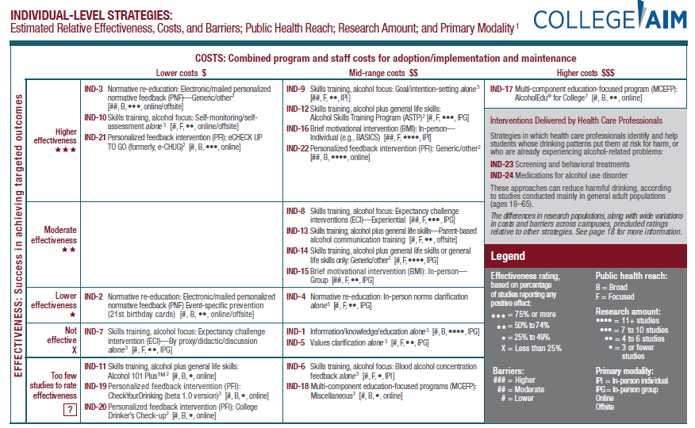

Slide 17
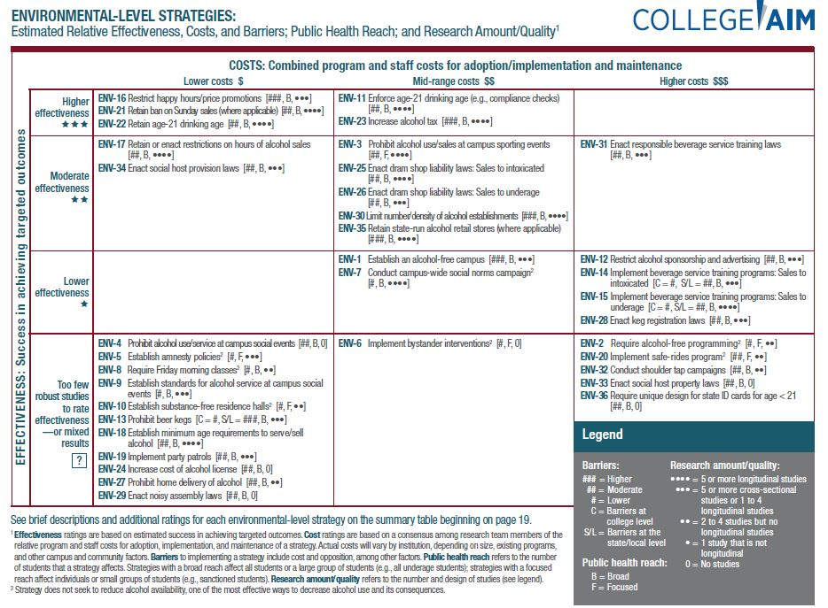

Slide 18
The Bigger Picture: Comprehensive Prevention
The combination of strategies through a comprehensive program has best evidence of success.
Applying individual-level strategies in a managed alcohol environment adds significant strength to individual strategies.
Adapting environmental-level strategies to student-led environments has promise as long as the larger campus environment employs environmental strategies as well.

Slide 19
The Understated Role of Autonomy in Prevention
Enabling students to recognize issues related to high-risk alcohol use intellectually and from a civic perspective
Enabling students to connect drinking behaviors to organizational and life goals
Allowing students to determine and enforce standards of behavior within their social groups
Employing individual-level strategies that encourage autonomy and challenge dominant expectations and norms from a minority of members.
Harper, E. (2007). Making Good Choices: How Autonomy Support Influences the Behavior Change and Motivation of Troubled and Troubling Youth. Reclaiming Children and Youth: The Journal of Strength-based Interventions, v16 n3 p23-28
Patrick, H, Williams, GC(2012). Self-determination theory: its application to health behavior and complementarity with motivational interviewing. International Journal of Behavioral Nutrition and Physical Activity20129:18

Slide 20
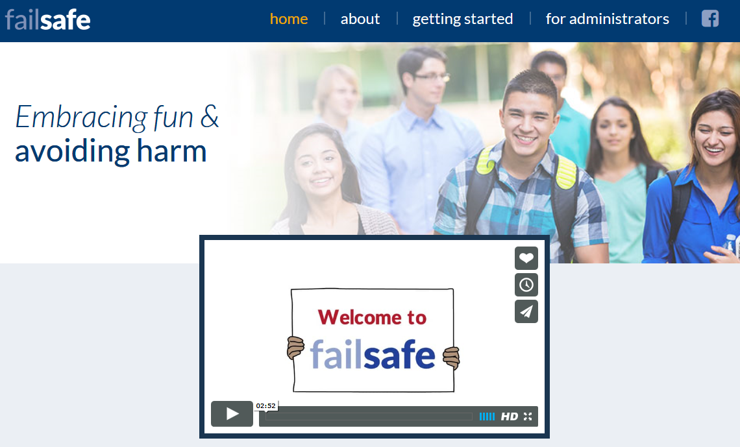

Notes:
In this context, we created Failsafe. Failsafe is a set of evidence-based tools that leaders of student organizations can use to help their club, fraternity chapter, or recognized student organization
Show website and describe

Slide 21
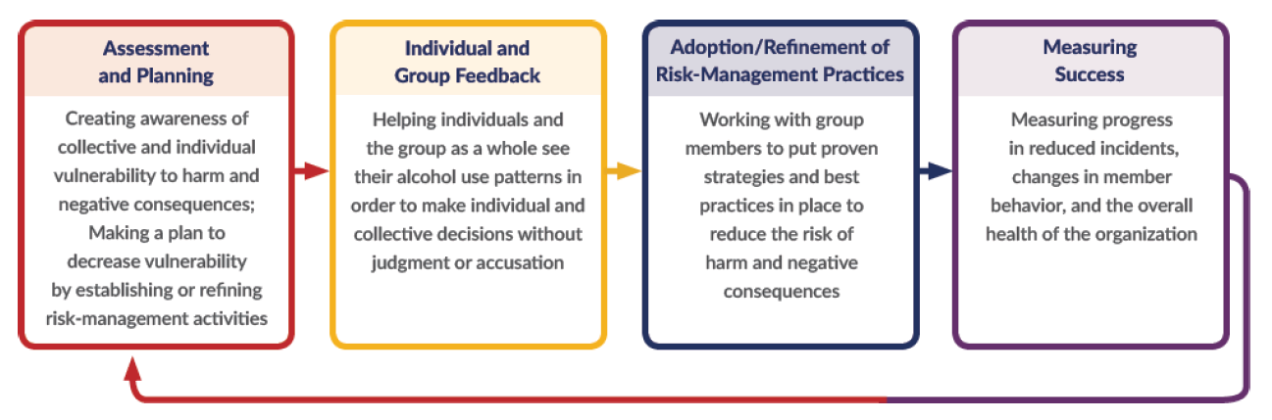
The Failsafe Group Process

Slide 22
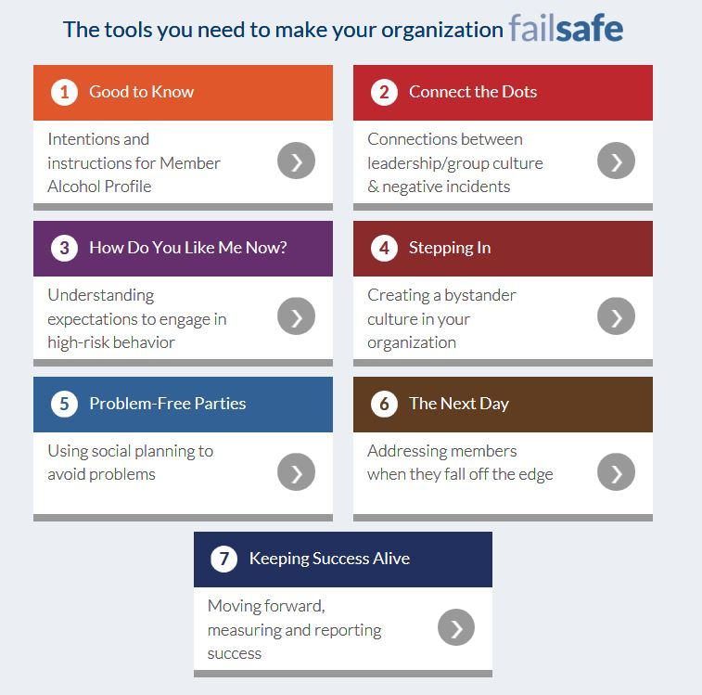

Slide 23
Why Failsafe?
Focused specifically on high-risk behavior in GROUPS
Allows student leaders to address risk autonomously
Addresses excessive consumption, not use of alcohol
Tools are student friendly, short, easy to understand
All tools are evidence-based strategies that work to reduce alcohol harms
Notes:
Failsafe focuses on high risk drinking in GROUPS – where high-risk drinkers cluster.
Failsafe targets excessive consumption and related behavior as a risk management issue – not as a moral issue. Focus is on removing RISK, not alcohol
Failsafe places turnkey instructions to applying evidence-based practices in the hands of student leaders who have significant influence on their peers.
Tools are student friendly – short, easy to understand, and can be integrated in existing group meeting sessions.
The tools are all based in solid evidence showing their effectiveness – show the NIAAA Matrix, show where failsafe fits on grids

Slide 24
Key Elements in Development
Advisory Panel of National College Prevention Experts
Student Leader Users Advisory Group
Online Assessment Design Vendor Erik Ping
Evaluation through the Nebraska Prevention Center
Digital development of modules and toolkit from the AIR Applied Technology Team offering state-of-the art digital learning tools

Slide 25
The Failsafe Pilot Test: Lessons Learned
Autonomy must be balanced with accountability
Needs an academic year
Failsafe may require prioritization over other activities
The environment must be sending continual messages of intolerance to poor risk management rather than to risk-taking behavior
The opportunity for mentoring leadership skills must be incorporated into the use of the toolkit
Better when a group recognizes the need to strengthen risk management rather than get out of trouble

Slide 26
Using Failsafe: New Models
Facilitated guidance through the toolkit
Peer educators add failsafe videos/activities to group sessions
Failsafe as hands-on leadership training
Engage alumni advisors to mentor through the toolkit
Can failsafe be sanctioned? Maybe, IF. . .

Slide 27

Questions, Comments
Tom Workman
tworkman@air.org
301-592-2215

