Slide 1
Welcome To The Wonderful World of Excel!
Objectives of this lesson:
Learn about entering screening data into a spreadsheet
Identify the components of a chart or graph of screening data
New Vocabulary

Slide 2
Entering Screening Data Into Your Spreadsheet
When you are entering data about a student it is helpful to label your columns with these common elements:
The date or time the data was collected
The names of the behaviors or skills for which you are collecting data
When you make a chart of this data, it will compare the changes in behavior or skill over time

Slide 3
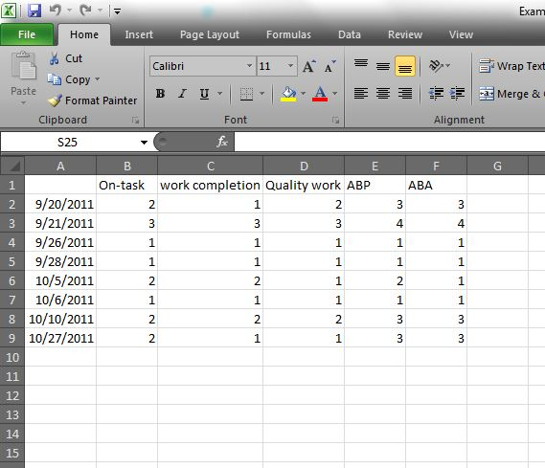
This is how it might look:

Slide 4
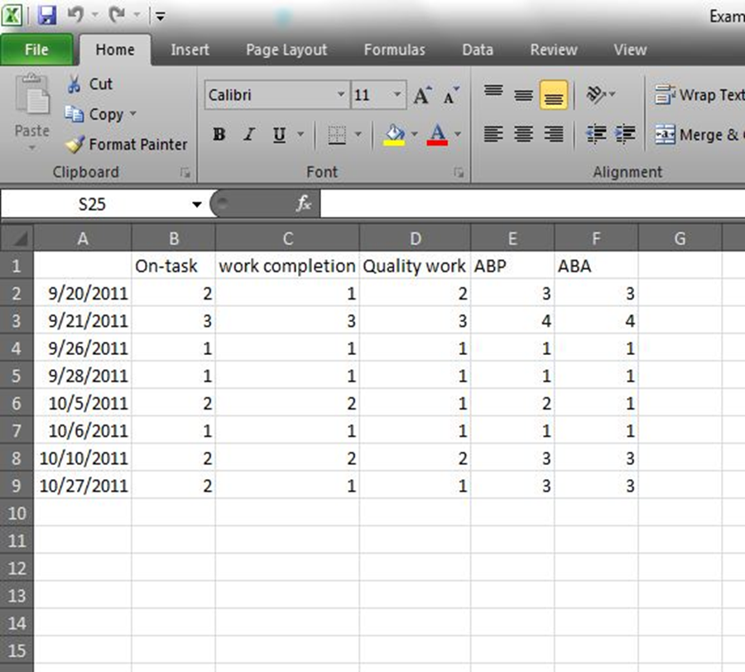
New Vocabulary!
Data Series
A group of numbers, like scores or ratings, identified by a label in a column or row of a worksheet that is plotted on a chart
The numbers in column B are a group of
numbers identified by the label “On-Task”
The numbers in column C are a group of
numbers identified by the label “Work Completion”
Each of these examples is a data series,
and can be plotted on a chart

Slide 5
More New Vocabulary!
Chart
This is a graphical representation of data
Chart and Graph are used interchangeably
Charts visually compare data
You can look for patterns and trends
The NU Data project primarily uses a marked scatterplot chart
Horizontal or X Axis
This represents the data series categories
They are plotted by the date you entered
Dates will appear along this axis
Each point is the behavior rated
Vertical or Y Axis
This usually represents the data scale
Such as a rating of 0, 1, 2, 3, and 4

Slide 6
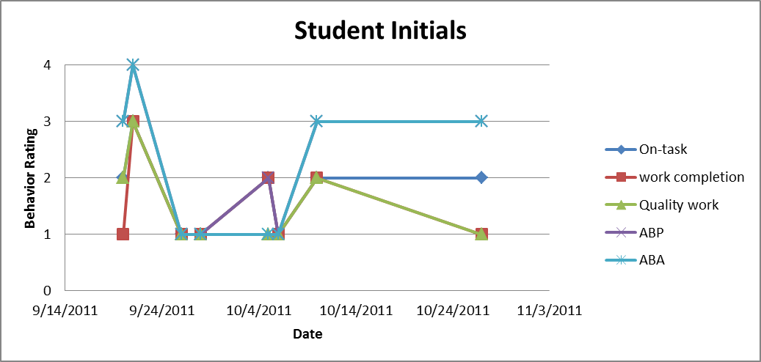
This is a marked scatterplot chart:
Four Data Series on one chart
The vertical axis shows the scale used to score or rate the behavior
The horizontal axis shows each data series over time

Slide 7
More Vocabulary!
Data Marker
A chart symbol, such as a dot or square, that represents a single data point or value from the worksheet
Legend
A list that identifies the patterns, symbols, or colors used in a chart

Slide 8
Here they are on the chart:
Data Marker
Legend
Remember, your charts should include titles and labeled axes.

