Slide 1

NU Data:
Selecting Data Collection Tools

Slide 2
The NU Data Project will identify, develop, and refine measures that allow you to collect relevant data that answer important questions about your students’ progress.

Slide 3
There are Eight Essential Characteristics that define a good measure:
1. Brevity
2. Simplicity
3. Graphability
4. Believability
5. Accuracy
6. Repeatability
7. Sensitivity
8. Reliability

Slide 4
The NU Data Project has identified 10 Measures that possess all the essential characteristics of a good measure:
Screening Measures:
1.Teacher Participation Report
Progress Monitoring Measures:
2. Daily Progress Report
3. Behavior Diary
4. Goal Attainment Scale
5. Self-Graphing Data Form
6. Scatter-Plot Data Form
7. Curriculum-Based Measurements (CBM’s/AimsWeb)
8. ClassMaps Survey
9. STEPS Measure
10. Check and Connect Monitoring Sheet
Notes:
NU Data identified 10 measures that possess all the essential characteristics of a good measure. More specifically, they identified one screening measure and one 9 progress monitoring measures. Screening measures are used to collect information on a range of student behaviors in order to identify problem areas. Once teachers have determined

Slide 5
Essential Characteristics of Measures
Brevity
Measures should be concise and unobtrusive so that data-collection does not interrupt learning and teaching

Slide 6
NU Data Measures
Scatter-Plot Data Forms
Used to track when, where and how often behaviors occur in a variety of contexts and settings
JC

Slide 7
Essential Characteristics of Measures
Simplicity
Measures should be uncomplicated so that the data analysis responsibilities fit seamlessly into a school day

Slide 8
NU Data Measures
Daily Progress Reports
Track disruptive behaviors using goal sheets that students carry with them to collect each teachers’ ratings of and comments about the appropriateness of their classroom behavior
0=No 1= Partly 2= Yes
Daily Progress Report Score: ___13___ (Total Points Earned) / ___24___ (Total Points Possible) = ____54___ %
 | Daily Subjects
GOALS | Reading | Math | Social Studies | Grammar | Science | Spelling
Talks respectfully to teachers/staff | 2 | 0 | 1 | 2 | 1 | 1
Raises hand when has something to say/share | 1 | 0 | 1 | 1 | 2 | 1
Total Points | 3 | 0 | 2 | 3 | 3 | 2

Slide 9
Essential Characteristics of Measures
Graphability
Measures should be easily transposed into meaningful graphs so that teachers, parents, and students can quickly understand, visualize, and plan from the data

Slide 10
NU Data Measures
Self-Graphing Data Forms
Collects discrete information on student behavior and/or skill development by tracking the completion of student-specific tasks
Provides instant feedback of student’s progress
GB

Slide 11
Essential Characteristics of Measures
Believability
Measures should be accurate and authentic so that teachers, parents, and students respect the results as useful and relevant

Slide 12
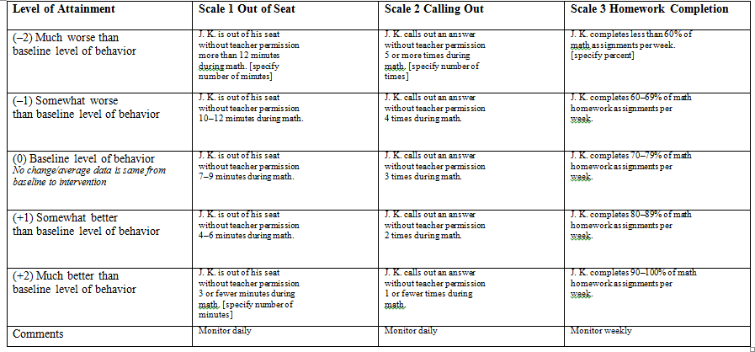
NU Data Measures
Goal Attainment Scale
Rate and measure student progress towards behavioral, academic and/or social goals using a structured rating system

Slide 13
Essential Characteristics of Measures
Reliability
Measures need to be internally consistent and show validity related to classroom success

Slide 14
NU Data Measures
ClassMaps Survey
Eight brief subscales describing important characteristics of classroom learning environments: teacher-student relationship, peer friendships, peer conflict, worries about peer aggression, home-school relationships, academic self-efficacy, self-determination, and behavioral self-control.

Slide 15
Essential Characteristics of Measures
Repeatability
Measures can be used repeatedly without being distorted by practice or familiarity

Slide 16
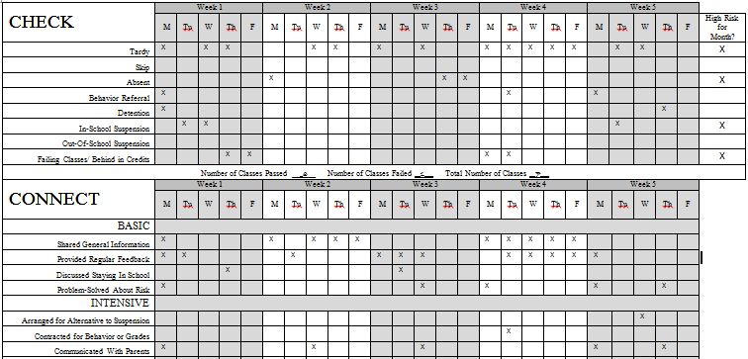
NU Data Measures
Check and Connect Monitoring Sheets
Used to continuously monitor student engagement by identifying and tracking warning signs of school withdrawal (e.g., absences, tardies, suspensions, etc.), while at the same time providing a home-school connection piece that monitors and encourages family-centered practices (e.g., problem solving, communicating with parents, participating in community service, etc.)

Slide 17
Essential Characteristics of Measures
Sensitivity
Measures will capture changes that might occur in response to interventions

Slide 18
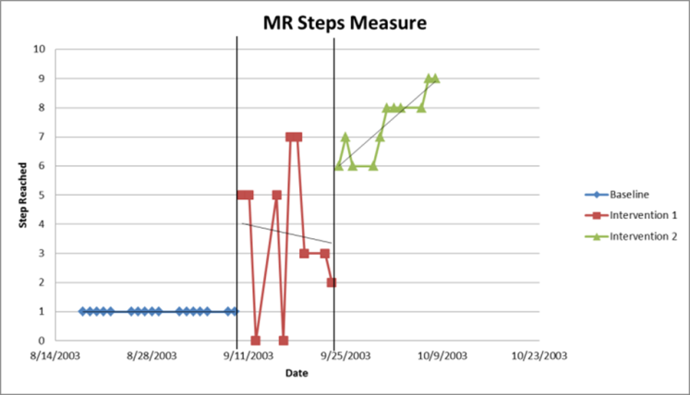
NU Data Measures
STEPS Measure
A measure that has a series of steps leading from the current level of performance of a behavior towards the desired level of performance of a behavior.
Example of Steps Measure and Graph
 |  |  |  |  |  |  |  |  | Recess
 |  |  |  |  |  |  |  | Both recesses
 |  |  |  |  |  |  | 1 recess by myself but talk to 2 kids
 |  |  |  |  |  | Outside 1 recess by myself
 |  |  |  |  | Eat in lunchroom with more friends; go to hall
 |  |  |  | Eat in lunchroom w/friend; go to hall
 |  |  | Eat in nurse’s office, 5 minutes in cafeteria, sit in hall
 |  | Eat in nurse’s office, walk thru cafeteria, sit in hall with book
 | Eat in nurse’s office
Hiding in bathroom

Slide 19
NU Data Measures
Behavior Diaries
Teachers or other adults record the occurrence of the behavior, the context (time, place, activities) when it occurred, and key antecedents or consequences
Goals | Key Behaviors to Record
1. During class/instruction time, Mark will refrain from falling asleep for four consecutive weeks 2. When voluntary assistance is requested, Mark will volunteer at least 5 times out of 10 times asked | Falling asleep in class__________ Volunteers___________________
Date | Place | Adults Present | Activity | Behavior | Consequence | Unusual Events | Comments
9/14 | Mrs. Jones’s room | Mrs. Jones & Mr. Smith | Math class | 1 | Recess Detention | Mark said he was tired
9/21 | Mr. Smith’s room | Mrs. Jones & Mr. Smith | Asked for volunteer to pass out science books | 2 | Verbal Praise
9/29 | Mrs. Jones’s room | Mrs. Jones | Reading class-asked for volunteer to read aloud | 2 | Verbal Praise, sticker |  | Mark said he knew the story

Slide 20
Essential Characteristics of Measures
Accuracy
The data collected describes progress towards the goal that is important for the student

Slide 21
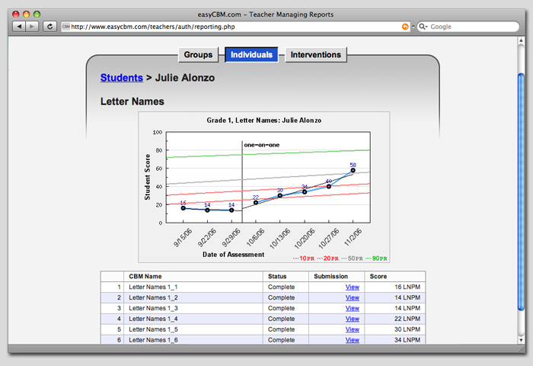
NU Data Measures
Curriculum-Based Measures (CBM’s)
Brief, simple, reliable, and practical measures of reading (e.g., words read correct), mathematics (e.g., digits correct), and written language (e.g., correct letter sequences) used to track students’ academic progress
Easy CBM Graph

Slide 22
The NU Data Project has identified 11 Measures that possess all the essential characteristics of a good measure:
Screening Measures:
1.Teacher Participation Report
Progress Monitoring Measures:
2. Daily Progress Report
3. Behavior Diary
4. Goal Attainment Scale
5. Self-Graphing Data Form
6. Scatter-Plot Data Form
7. Curriculum-Based Measurements (CBM’s/AimsWeb)
8. ClassMaps Survey
9. STEPS Measure
10. Check and Connect Monitoring Sheet

Slide 23
Questions to Consider When
Planning Data Collection
Is the target problem clearly defined?
  Have you defined the problem in such a way that any adult could identify the target problem as you identify it?
Is the target problem easily observable?
  Could you tally, rate, or time the behavior?
Is the target problem easy to count?
  If yes, consider using a scatter plot, progress report, checklist, or goal attainment scale
  If no, consider using a behavior diary, rating scale, or self-report
Is the method of data collection sensitive to change*?
  Does it capture changes in intensity, frequency, and/or duration of target problem?
Notes:
This is an important question to consider when looking at behaviors that may be high frequency-low intensity, e.g. call-outs OR low frequency-high intensity; e.g., tantrums

